Slide 1
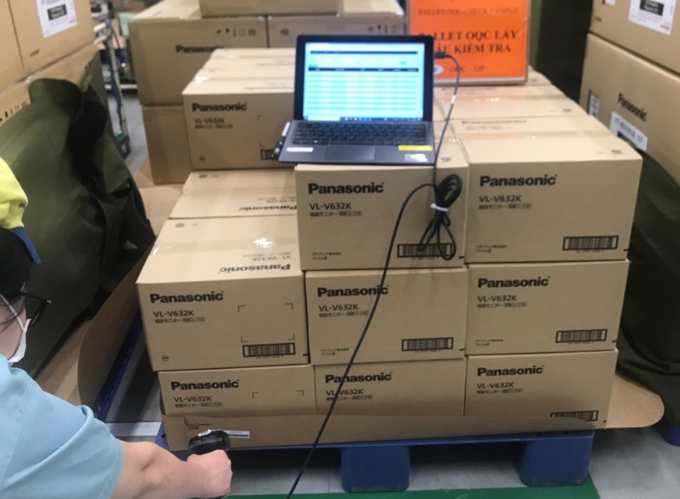
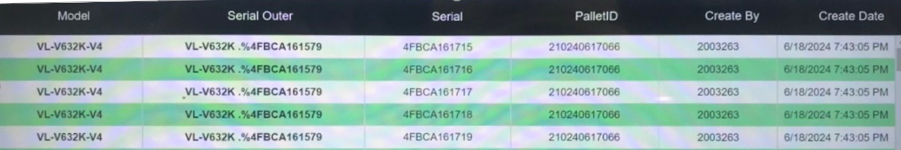
Review OQC sampling method
Assy
Packing
ID Pallet station
FA warehouse
SCM warehouse
Shipment
Case 1
OQC
OQC
Case 2 : For HC400 serries
ID pallet issue in FA process
Case 1 : OQC pick up sample before ID pallet ➔ Return to ID pallet station
( ID pallet station : Reading Inner carton S/N - Outer carton S/N → issue ID pallet )
→ No risk for wrong packing inner box S/N and outer box S/N
→ Need to review OQC area how to control Product S/N and Inner carton S/N
Case 2 : OQC pick up sample after issue ID pallet ( Ratio : 2% )
Pickup sample
Record ID pallet
OQC sampling check
Return to SCM W/H
Step 1: Recorded ID Pallet and
S/N carton box by excel file
Step 2: Matching ID pallet and Outer
carton before return
No risk for return wrong pallet
Need to review OQC area how to control Product S/N - Inner carton S/N – Outer S/N

Slide 2

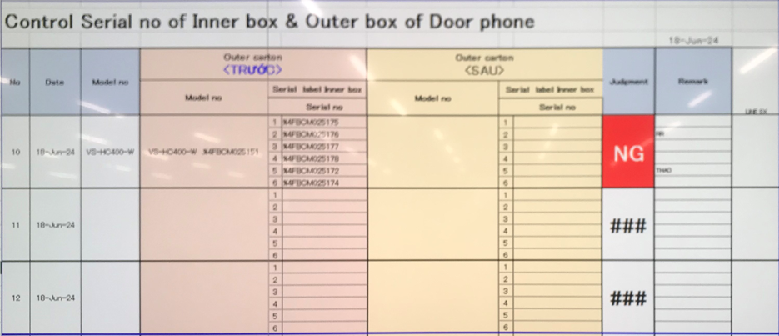
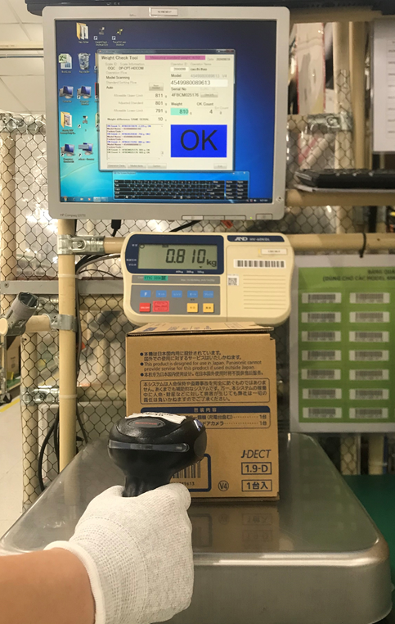
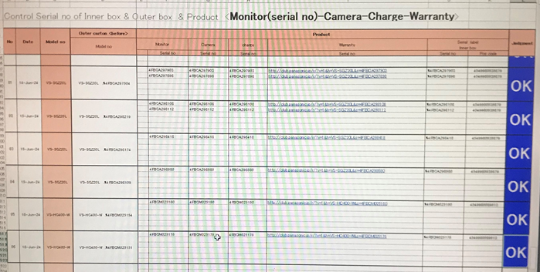
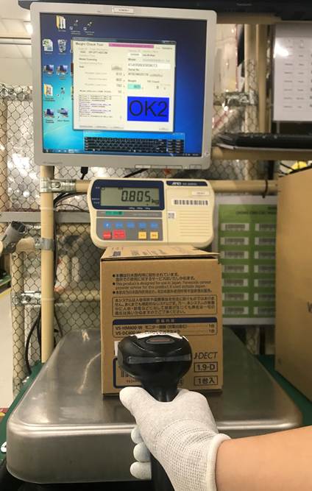
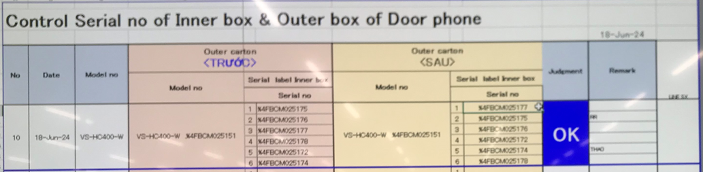
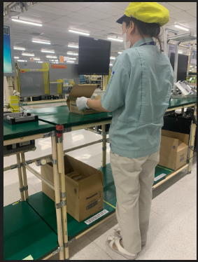
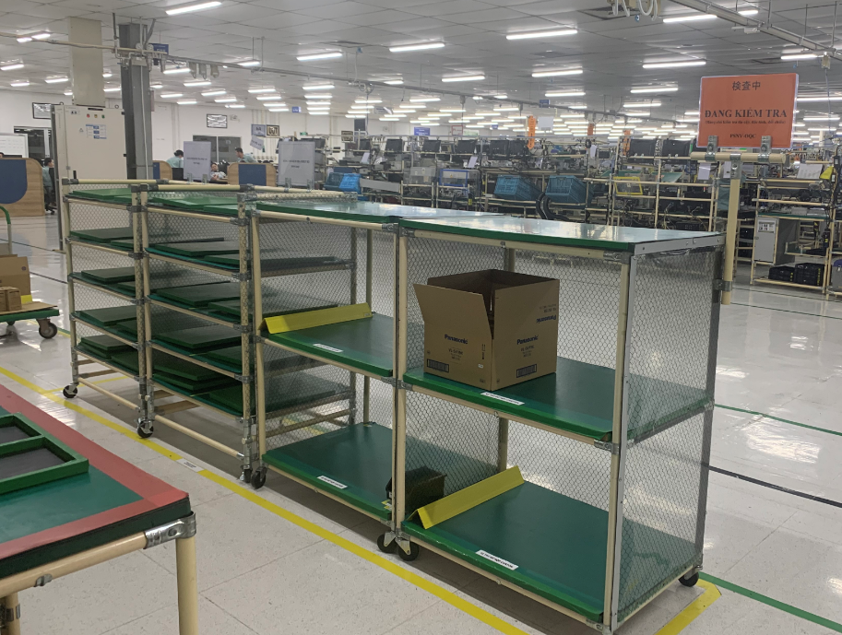
Review control sample at OQC area ( System control )
Pick up sample
Reading barcode Inner/Outer
Weight check 1st
OQC
inspection
Reading BC
Product / Inner
Weight check 2nd
Reading barcode
Inner/Outer
Return to Pallet
Reliability
Confirm S/N Outer & all inner boxes
Accessory control
Numbering control & Separate area
Product / Warranty/ Manual & Inner box
Accessory control
Confirm S/N Outer & all inner boxes
*In case not matching Product / Warranty/ Outer & Inner ➔ Can find out before packing
Physical control
1person – 1 model
– 1 table
Same time inspection
Reliability test area separate control and clear indication
After reliability test , product return to check full OQC item

Slide 3
Project: Link weight check system FA-SCM-OQC
FA
Pallet ID
SCM
Shipment
- Weight check
- Pro date/Model/Q’ty
- Issue FG control sheet
- Issue Pallet ID: Model/Q’ty/SN
- Issue Movement slip <SAP>
- Read Pallet ID Model/Q’ty>
- Take out FG control sheet>
- Compare FG & WMS
- Read Pallet: <Model/Q’ty>
- Take out FG control sheet
- Compare FG & WMS
CURRENT SITUATION
OQC
- Sampling pick up
Additional
Additional
Additional
Additional
① Add OQC :
Input sampling plan
Input Sampling product & Serial No
② Indication OQC situation:
Input Sampling result
Input total judgment All lot.
→ Send result by Email auto
③ QC inspection result:
Reading Pallet ID to check OQC result
Indicate OK lot
④ Function: If OQC judgment NG or Not yet
Stop next step
< PSNV/ Jupiter >
Study to link weight check & WMS
REQUEST
MERIT
Save:
8,000min/month
4000 paper
Save:
Reduce 2pax
990H/year
Save:
4,000 min/month
Note: Model not have S/N → Control as current method

Slide 4
1/1
Project: Link weight check system FA-SCM-OQC
◆Before
◆ After
FA
OQC
SCM
FA
Link
OQC
Link
SCM
. No indicate shipment priority
. No indicate result timely
. Cannot use weight system → compare S/N by manual
. Update OQC result not timely.
. Loss time to come to SCM for chop stamp.
. Loss time to confirm stamp by visual check
. Indicate result timely
. Indicate shipment priority
. Use weight system → auto compare S/N
. Online update OQC result & Save time to come to SCM for chop stamp
. No need check stamp by visual
. Confirm OQC result by system
Target improve:
Prevent wrong packing leakage out to market
△ 2pax for stamp by manual
2pax
OQC Issue
Risky point : Wrong packing pass to market by control offline
Loss time to confirm production result & Shipment schedule : 90sec*150lots=3.75H/day.
2pax/ day need to follow chop stamp in warehouse.
Improvement: Link system from FA-OQC-SCM
Prevent wrong packing.
Save time : 3.75H/day ~ 990H/year
Save manpower : △ 2pax for stamp ~ 12K$/ year

Slide 5
OQC DIGITAL SYSTEM
2
Overview of the OQC inspection process
OQC chop stamp procedure
Steps
1
NG
Notify NG error for FA
Pick up sample
2
9
First check
Find Pallet ID & F/G
OK
3
OQC inspection
10
Matching Pallet ID & Outer carton
4
OQC inspection
11
Record Pallet ID & S/N carton
5
Check S/N inner product
12
Find all lots same model, shift, date, line
6
Weight 2nd
7
Second check
13
Chop stamp physical all lots
8
Return sample
14
Report daily
OQC inspection result no link FA & SCM system, easy mistake. (7 steps)
All procedures are manual by Excel, loss time to traceability, and skip processes.
The results of the inspection process are manually stamped. Loss of time to stamp.

